Slide 1
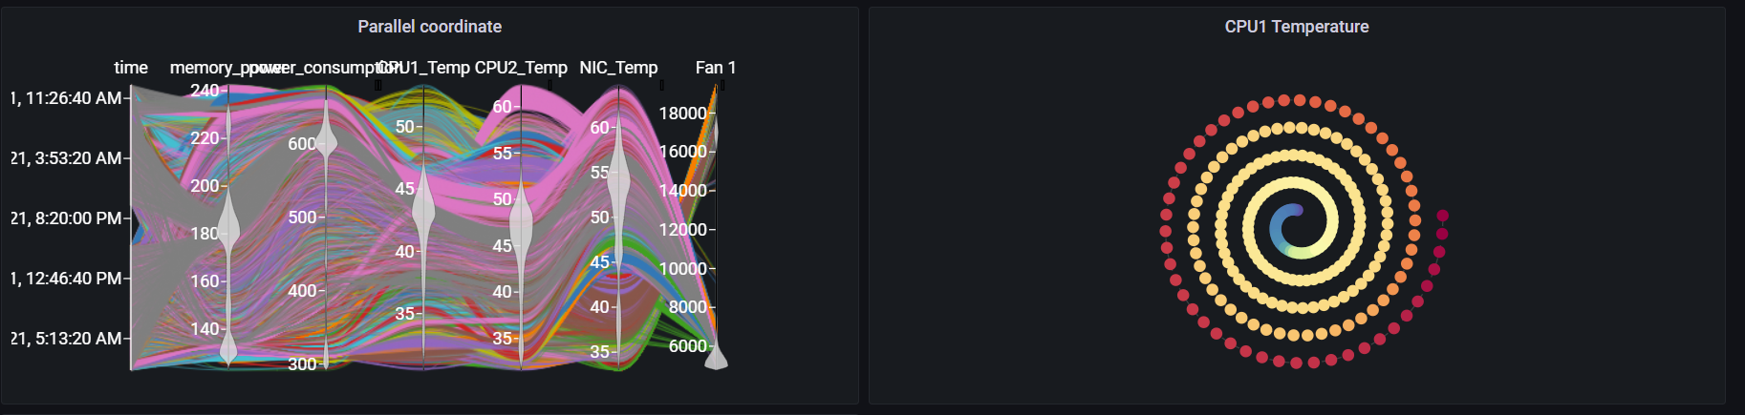
Grafana Plugin
Weekly report

Slide 2
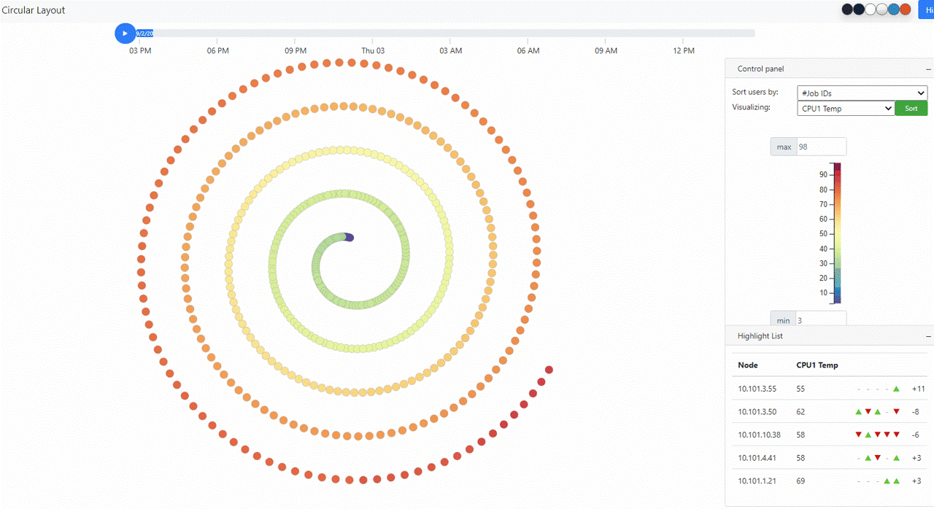
Original visualization
https://idatavisualizationlab.github.io/HPCC/spiralLayout/index.html

Slide 3
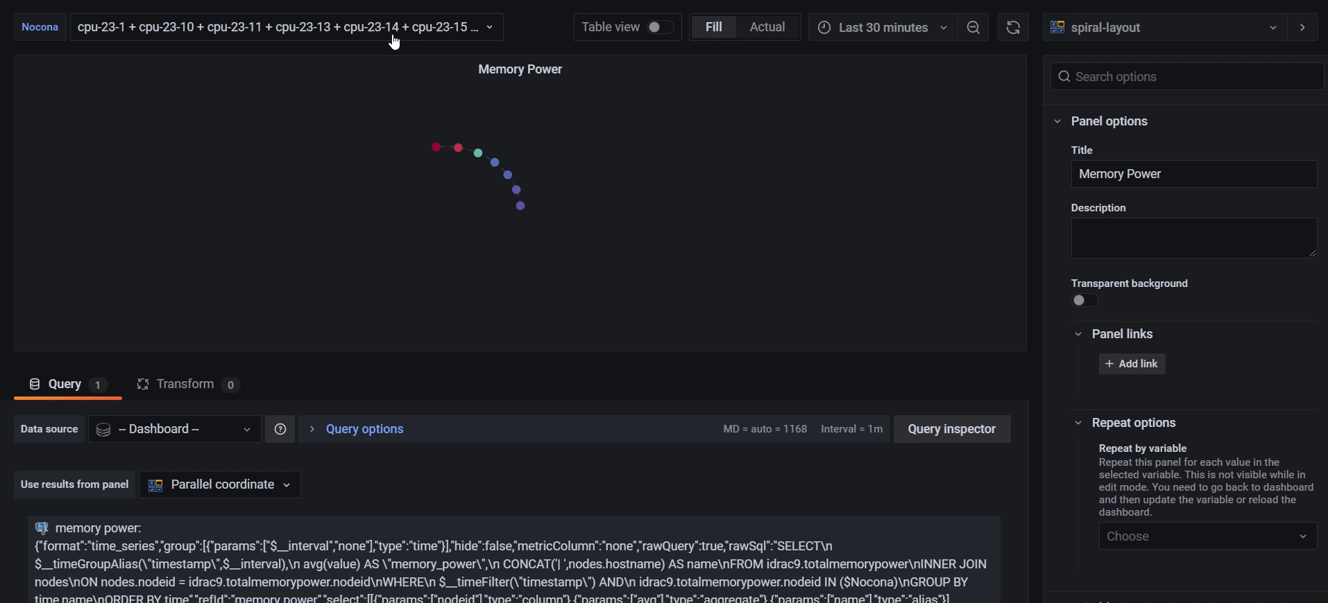
Previous features

Slide 4
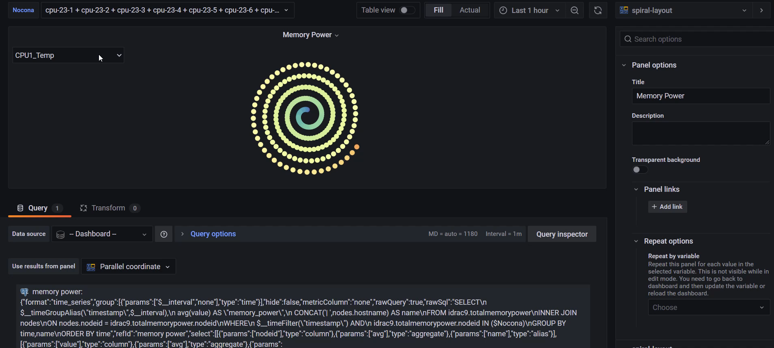
Previous features

Slide 5
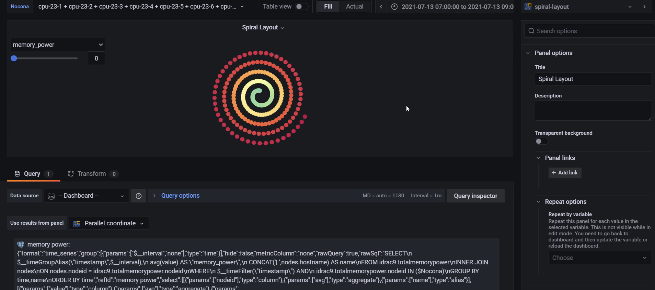
Current features

Slide 6
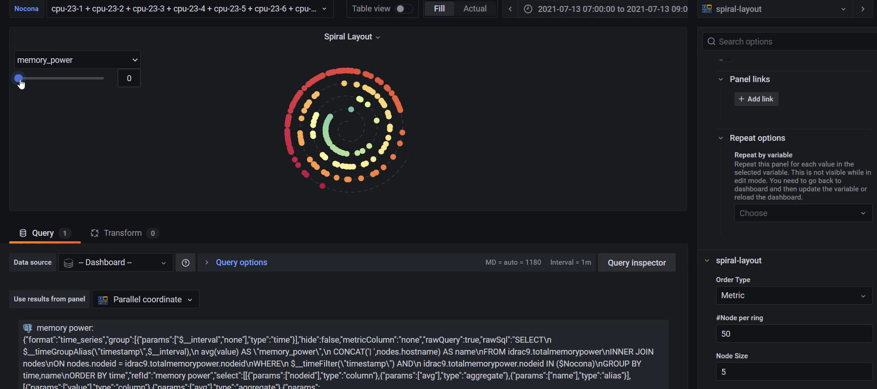
Current features

Slide 7
Current features
Linear scale and None linear scale for spiral layout
Selectable metric
Quick tooltip
Selectable time range
Trajectory (heatmap)
Hold selection by click

Slide 8
Future features
Adjust time range in Time format
Fixed metrics dimension

Slide 9
Job related data
Able to query job data with the query by time and running node:
SELECT *FROM slurm.jobsWHERE start_time < ${__to:date:seconds} AND end_time BETWEEN ${__from:date:seconds} and ${__to:date:seconds} AND ARRAY[${Nocona:csv}] && nodes
This query no longer working since the node is not the node id but node name

Slide 10
PowerMap
Transfered 80% code:
100% visualization code
60% data processing code

